Slide 1

Bicom Systems presentation to ‘you’
Presenter: Stephen WINGFIELD
September 2012 / SHawwal 1433 A.H.
www.bicomsystems.com

Slide 2



























Our Customers
www.bicomsystems.com

Slide 3
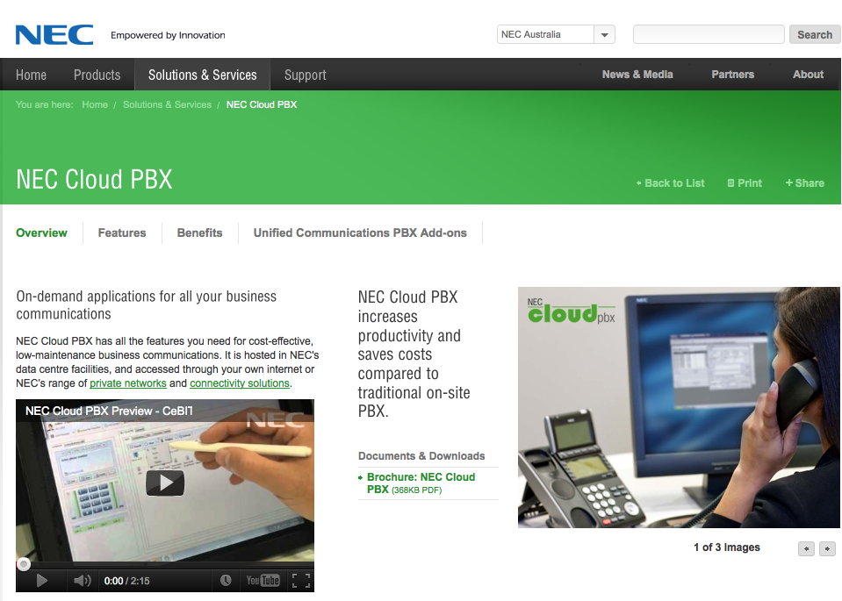
NEC Cloud PBX
www.bicomsystems.com

Slide 4
Overview Bicom Systems
Group Founded 2003 to Unify Communications
Fall 2004 PBXware was Launched Publicly.
The World’s First: Professional Open Standards Turnkey Telephony
System.
1000s of SMB, Corporate, Governments, Service Providers
Worldwide Offices:
HQ UK, France, USA, Bolivia, Bosnia and Herzegovina
Company is debt-free, private and driven by the founders
www.bicomsystems.com

Slide 5

Corporate Statements
Mission Statement:
  We provide the Communicating World with the most Complete Turnkey Communication Systems available by Creating, Unifying and Supporting the Most Advanced of Current Technologies.
Strategy:
  To focus on the production of quality systems while building solid lasting relationships with local partners to achieve the furthest fastest reach for our products.
Goal:
  To LIBERATE the world from Traditional Communication Systems.
Business Model:
  Software
www.bicomsystems.com

Slide 6

Business Units
PBX Systems
  Business/Enterprise PBXware Editions
Call Centre Solutions
  Inbound/Outbound and Predictive Dialler
Service Provider Solutions
  SERVERware, PBXware MT Edition
Telephony Services
  UK, USA DIDs,Termination/Origination
www.bicomsystems.com

Slide 7
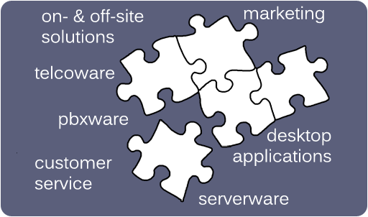
All The Pieces…
Our products piece together natively to give you all the parts of a turnkey phone company.
www.bicomsystems.com

Slide 8

SERVERware
Cloud IP Services Delivery Platform
SERVERware is a next generation CLOUD platform for communication technology solutions.
Delivers a wide range of IP services and
applications, using "virtual servers" technologies.
It is redundant, highly available and fault tolerant.
It features comprehensive
management, flexibility, self
healing and an unlimited scalability
of host and virtual servers.
www.bicomsystems.com

Slide 9
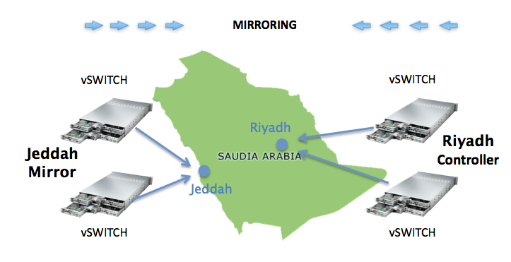
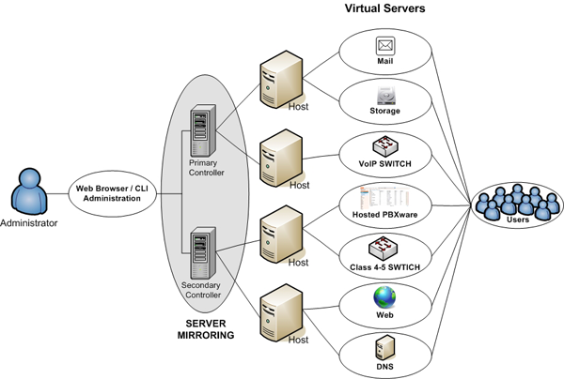
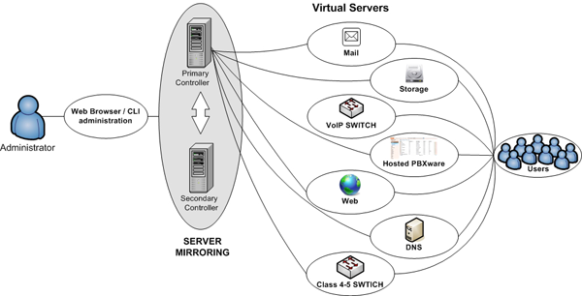
SERVERware
Cloud IP Services Delivery Platform
SERVERware Server Edition
Max Capacity : 400 concurrent calls.
Start-up ITSP can be deployed quickly.
SERVERware Network Edition.
Expandable to Very Large ClustersIntroduced.
SWITCHware to tie together the PBXwares.
Dual Location Redundancy
Provides for protection against
Acts of Terror and Naturual Disaster
www.bicomsystems.com

Slide 10
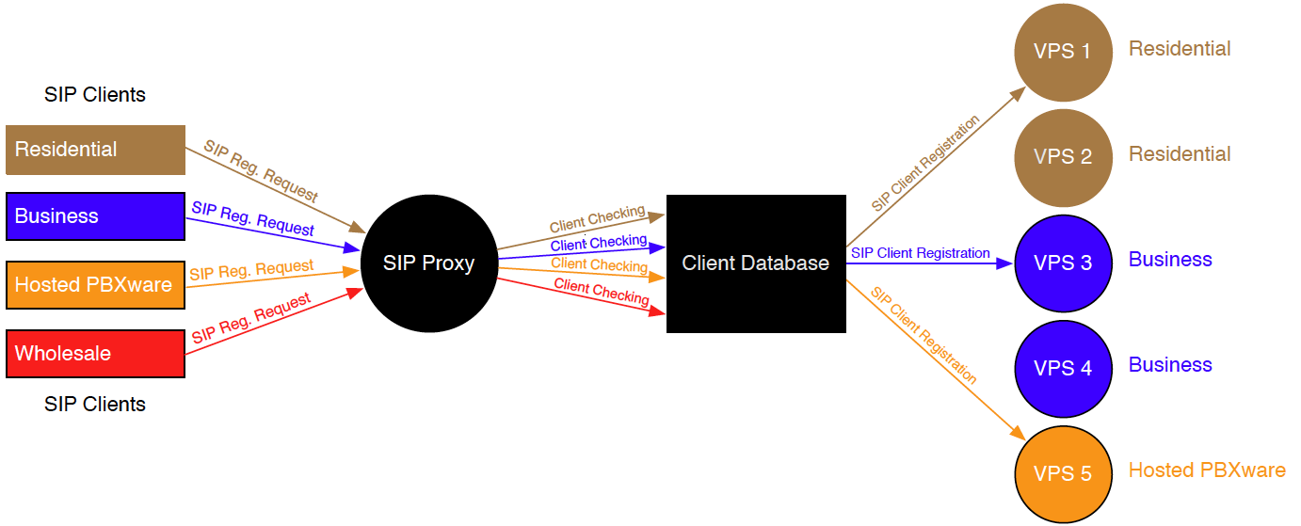
SWITCHware
SIP Proxy/SBC
Outgoing/Incoming Calls for Residential & Business Users
Hosted PBXware Users
Wholesale users
www.bicomsystems.com

Slide 11

PBXware
PBXware is the world's first and most mature Professional Open Standards Turnkey Telephony Platform.
Reliable and Scalable
Easy To Setup And Use
Unified Communications
Desktop Applications
Call Recording & Monitoring
Call Routing Support
Conferencing
Fax Over IP
Comprehensive User Features
OnSite & Cloud Hosted IP PBX
Real Time Telephony Billing
Integration with CRM/CTI Systems
Custom Development
www.bicomsystems.com

Slide 12

PBXware Business
Business
PBXware Business Edition provides the business class with features required by today's demanding communications needs that all businesses face.
Standard features of all New Generation IPPBXs.
Comprehensive enhanced services.
Telephony applications.
End user applications.
Customization.
Reliability.
www.bicomsystems.com

Slide 13
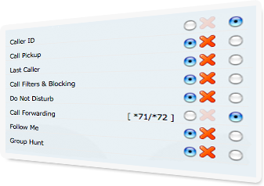
Comprehensive User Features
• Group Hunt
• Call Forwarding
• Call Park
• Instant Recording
• Call Pickup
• Call Filters & Blocking
• Speakerphone Page
• Directory / BLF List
• Listen to Recordings
• Call Monitoring
• Phone Callback
• Overhead Paging
• Paging/Intercom
• Remote Access
• Personal IVR
• Monitoring Conferences
www.bicomsystems.com

Slide 14
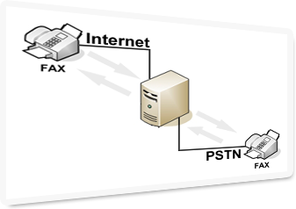
Fax Over IP
Fax Over IP and traditional PSTN faxing allows exchanging fax calls between two fax machines, connected to a network (Internet) or/and to a traditional phone line.
www.bicomsystems.com

Slide 15

Call Recording, Monitoring, Barging
Call Recording
System Wide Call Recording
Call recording per user extension
Instant Recording
Call Monitoring
Listening to calls
Whispering
Barging into calls
www.bicomsystems.com

Slide 16
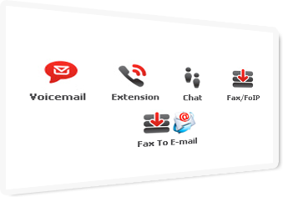
Unified Messaging
PBXware brings together Voicemail, Instant Messaging Chat, Faxing, SMS, Online Presence, Call Center Agents, Outlook/MS Exchange Directory etc. creating unified communications, giving our customers extended advantage in every day business life with our Desktop Applications.
www.bicomsystems.com

Slide 17
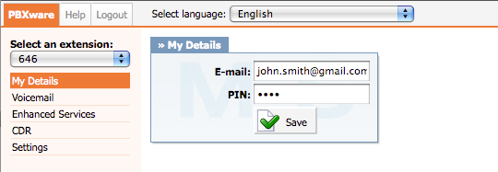
Web User Self Care
This features management and administration of:
User E-mail address and PIN
Voicemail
Enhanced Services
CDR (Call Details Records)
www.bicomsystems.com

Slide 18
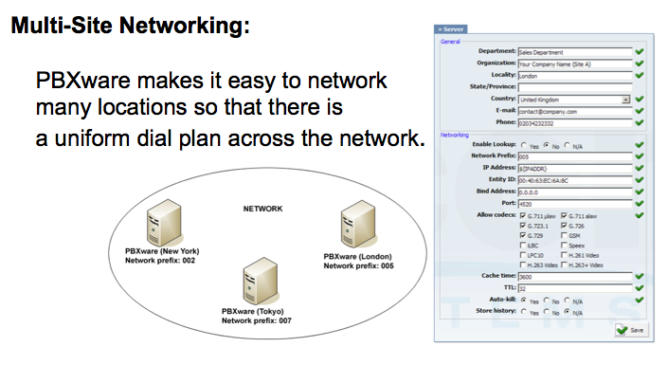
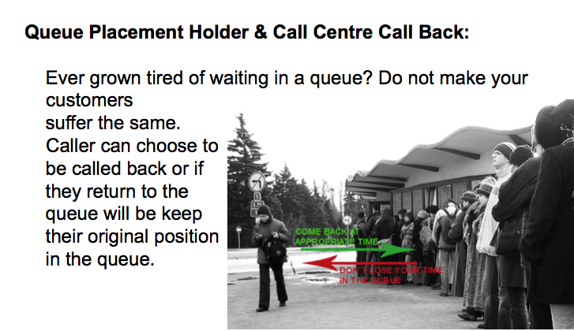
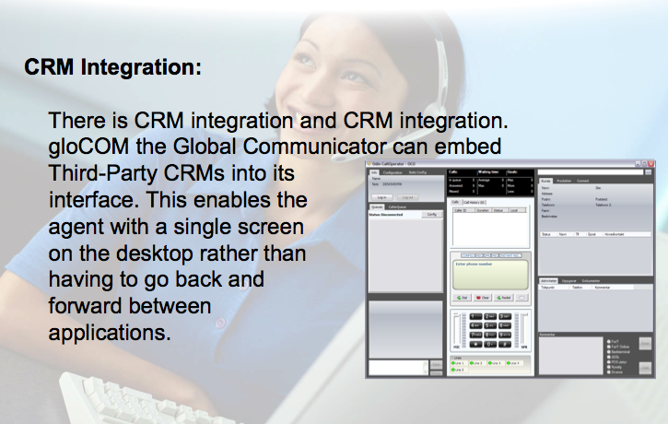
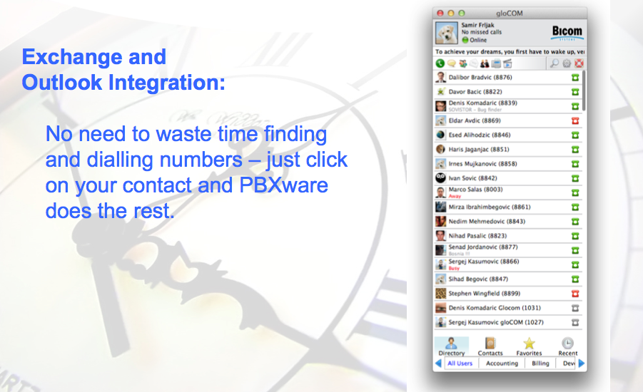
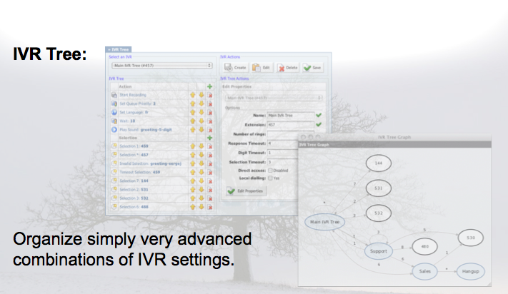
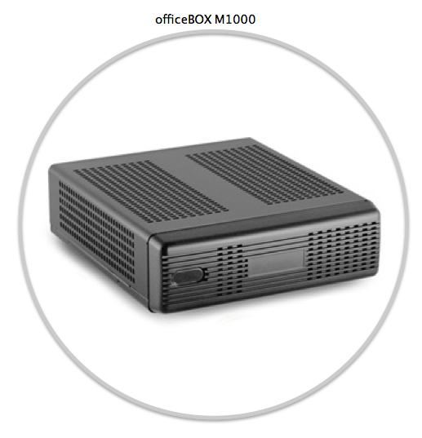
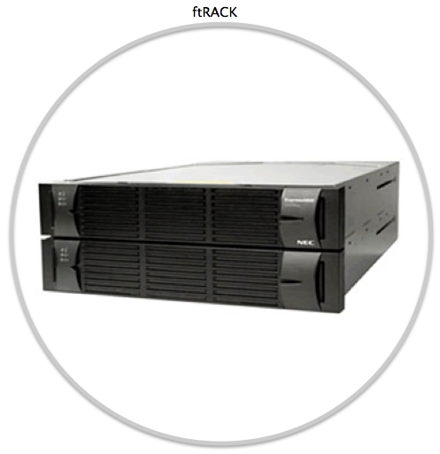
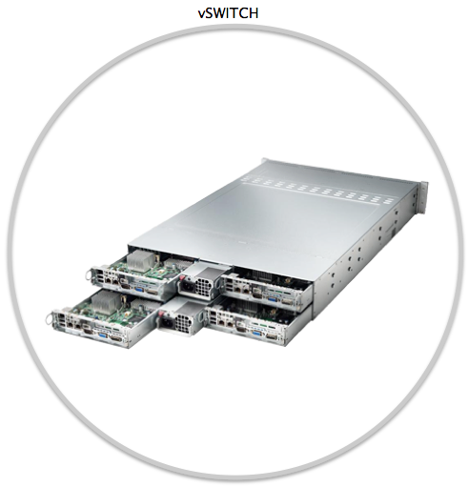
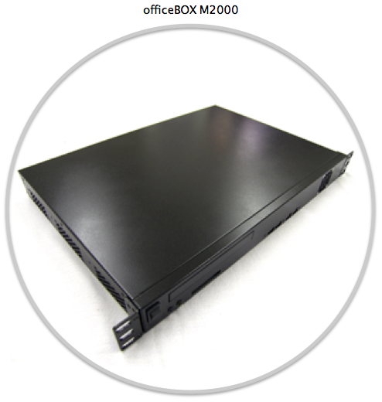
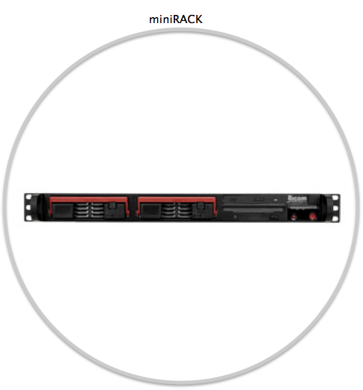
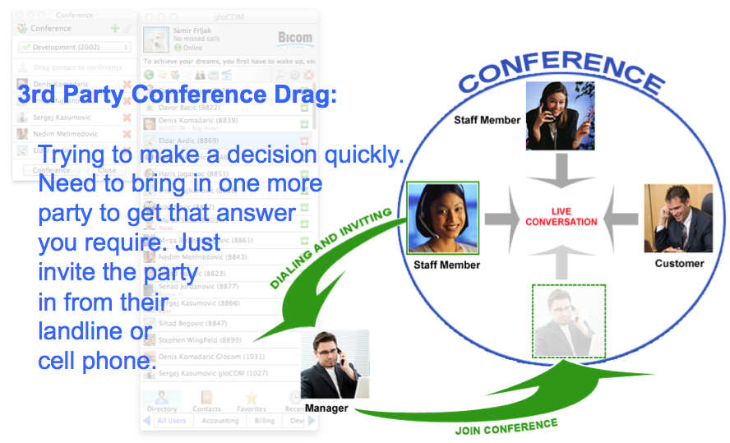
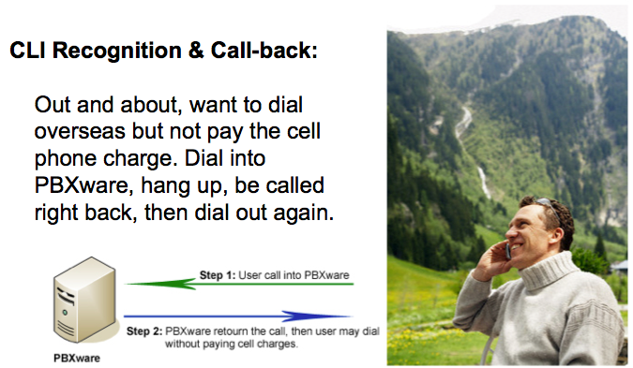
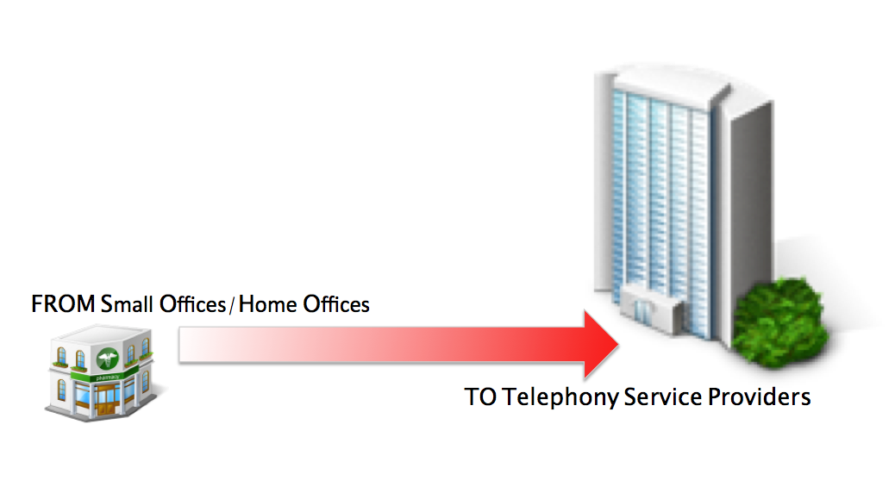
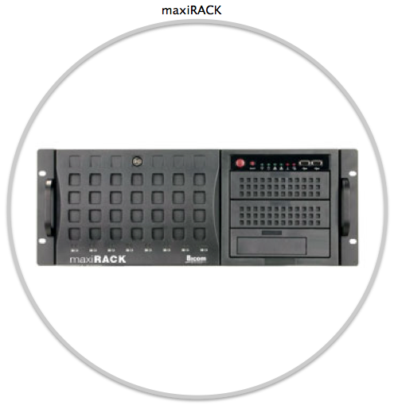
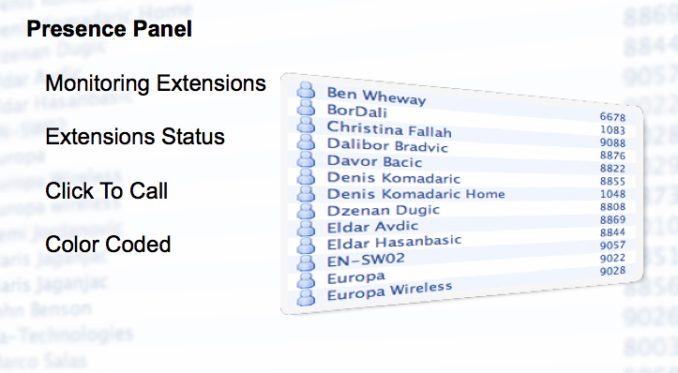
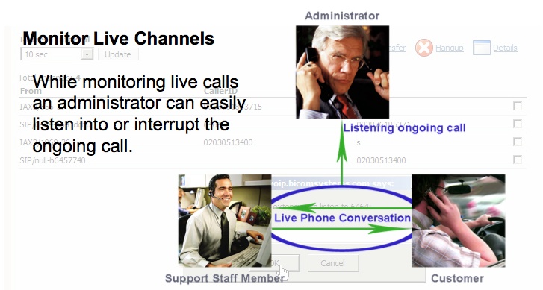
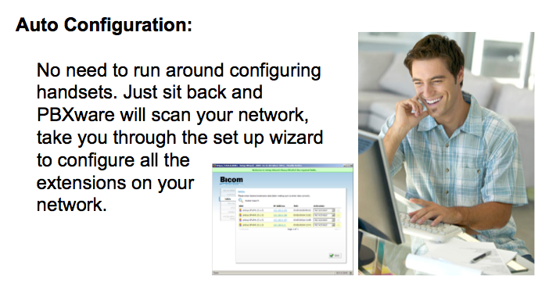
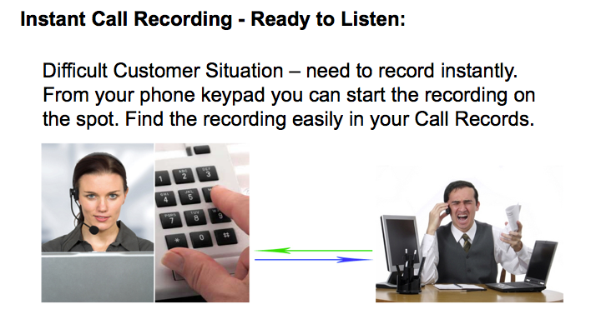
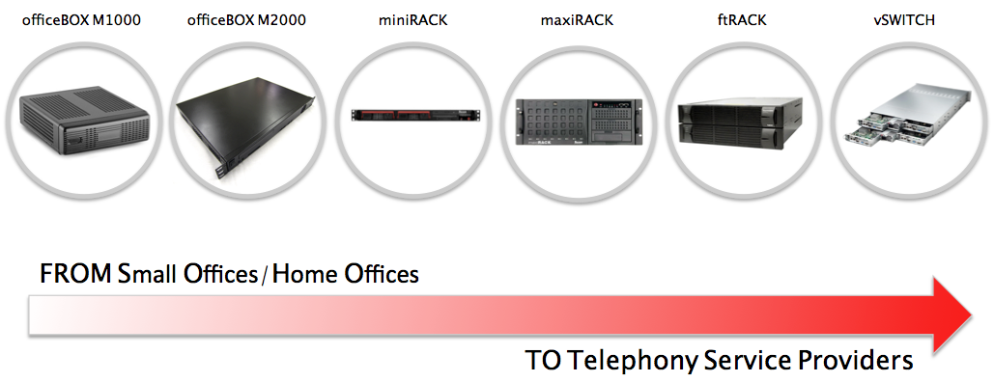
… all the features
… all the sizes
AND MUCH MORE...
CLI Recognition & Call-Back
Multi-Site Networking
IVR Tree
Exchange & Outlook Integration
Monitor Live Channels
3rd Party Conference Drag
CRM Integration
Auto Configuration
Queue Placement Holder & Call Center Call Back
Presence Panel
Instant Call Recording - Ready to Listen
AND MUCH MORE...
www.bicomsystems.com

Slide 19
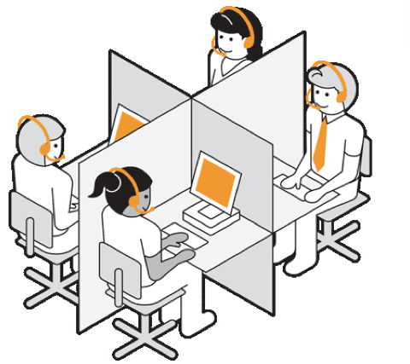
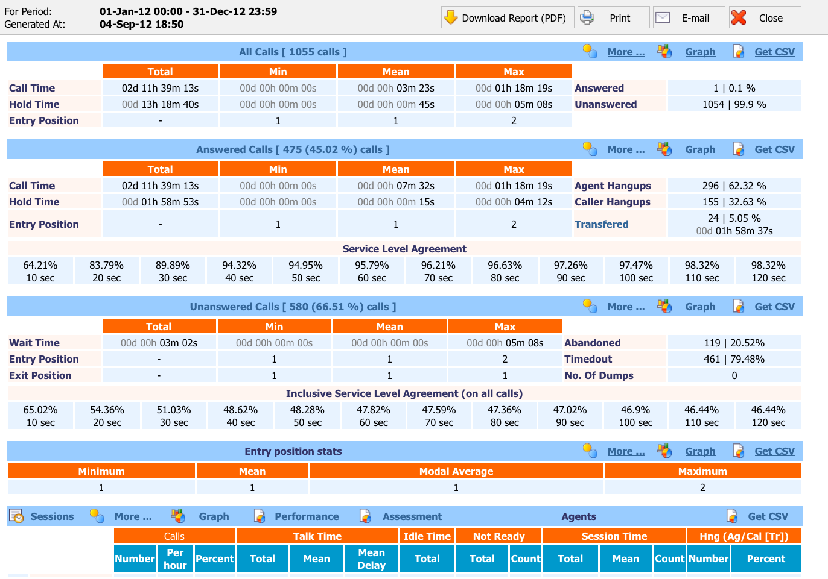
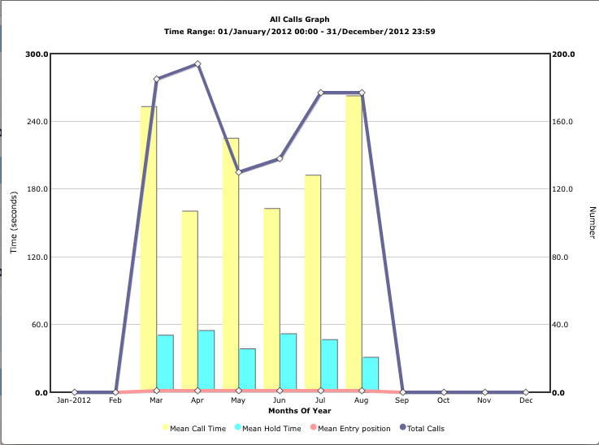
PBXware Call Center
Call Center
The Call Center Editon offers a set of features needed for an organization to effectively start and manage inbound or outbound call campaigns.
Call Center Communicator.
Call Center Statistics.
Real Time Agent Monitoring.
www.bicomsystems.com

Slide 20

PBXware Call Center
AQMON
AQMON allows call center agents and supervisors to monitor queues and agents' status in real-time. Agents can view real-time queue statistics on a large LCD screen. Supervisors, on the other hand, can monitor the comprehensive and detailed real-time statistics on agents.
• Full Screen View
• Monitor Slide Show
• Call Details
• Queue Status
• Agent Status
www.bicomsystems.com

Slide 21
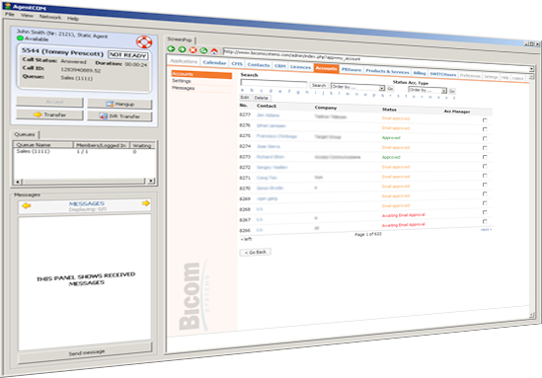
PBXware Call Center
agentCOM
AgentCOM is a specialized call center application designed to create an easier day-to-day workload for agents in busy call centers. It enables agents to easily answer/reject/transfer calls, send messages to the supervisor, monitor queues, or interact with any web based CRM.
Call Transfer
Reject Call
IVR Transfer
Always On Top
Bring On Top
URL Pop up
Call Status
Queue(s) Information
Supervisor Messages
Integrated Web Browser
Message History
Show Tabs In Separate Window
3 Skin Mode
Not Ready Status
www.bicomsystems.com

Slide 22

PBXware Multi Tenant
Multi Tenant
The MultiTenant PBX Edition of PBXware gives Telecom Service Providers a powerful platform to serve the IP-PBX market in the cloud.
Unlimited Hosted IP-PBX Multi Tenants.
Cloud Hosted IP PBX.
Unlimited Resellers.
User/Company Self Portal.
www.bicomsystems.com

Slide 23

PBXware Multi Tenant
Benefits of a Hosted System over an Onsite System
No upfront costs
No software or hardware purchases necessary
No upgrades necessary
Customizable
Backup and recovery options
Faster deployment
Simple, unified
www.bicomsystems.com

Slide 24

TELCOware
TELCOware… “All the rest of puzzle pieces you have been looking for to become a Turnkey Service Provider”
Billing.
CRM & Customer Ticketing.
CMS & Shopping Cart.
Customer Accounts.
Products and Services.
Switch Integration.
www.bicomsystems.com

Slide 25
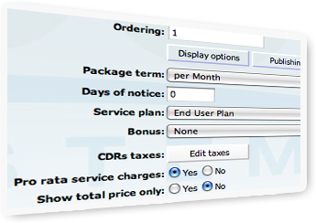
TELCOware Billing
• Recurrent Invoices
• Unlimited Packages
• Unlimited Service Plans
• Custom Invoices
• Outstanding Balances
• CDR Mediation
• Customer Subscriptions
• Customer Statements
www.bicomsystems.com

Slide 26
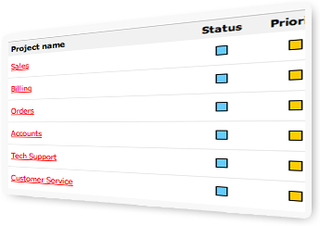
TELCOware CRM & Customer Ticketing
• Unlimited Projects and Tasks
• Unlimited Customer Tickets
• Web Based or Email Client
Customer Ticketing
www.bicomsystems.com

Slide 27

TELCOware CMS & Shopping Cart
• Telephony DIDs/Service plans ordering
• Content Role Based Administration
• Unlimited Website Pages
• Website Content Management
• Unlimited Shopping Cart Items
• Professional, Instant & Bespoke Designs
• Custom Search Engine Marketing
• Files Upload & Manipulation
• Images Security
www.bicomsystems.com

Slide 28
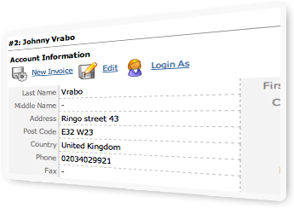
TELCOware Customer Accounts
• Accounts Based Content
• Unlimited Account Types
• Account Search
• Account View by Status and Type
• System to Account(s) Messages
• Call Spend and Call Billed View
www.bicomsystems.com

Slide 29
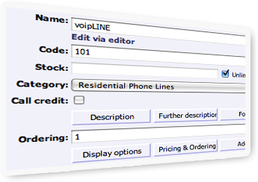
TELCOware Products and Services
• Unlimited Prices
• Unlimited Categories and Items
• Time and Quantity Based Discounts
• Display Modes and Publishing Option
• Small, Large and Zoom Images
• Item Add-ons
• Auto PSD Publishing
www.bicomsystems.com

Slide 30
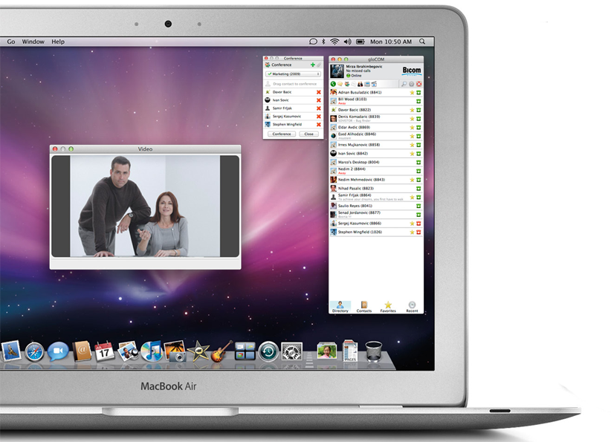

gloCOM
All Your Communicating Together
ETIHAD !
gloCOM
THE FUTURE OF ENTERPRISE AND
CALL CENTRE COMMUNICATION
Desktop and mobile application
Designed to enhance communicating capabilities of enterprise and call center staff
Simple and efficient business solution
Works on: MS Windows, Apple Mac OS X, Linux Ubuntu, Apple iOS, Google Android
www.bicomsystems.com

Slide 31
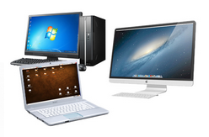

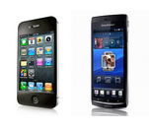
gloCOM
All Your Communicating Together
ETIHAD !
gloCOM
THE FUTURE OF ENTERPRISE AND
CALL CENTRE COMMUNICATION
CRM Integration
Quick Actions
Ease of Use
Personalization
Call Center Features
Voice & Video Calling
Instant Messaging
Audio & Video Conferencing
Contacts Management
Faxing
…and best of all IT’S FREE!
www.bicomsystems.com

Slide 32
Why Bicom Systems Software ?
Best of Both Worlds : Flexibility of Open Source & Guaranteed to WORK
Eight Years of Pedigree and Maturity
Dev Track influenced by increasing numbers of Incumbents and Competitors
providing Technological Advantage
Turnkey Principal is Pervasive providing Organisational Advantage
Rapidly Expandable, Highly Redundant and Stable
Business Model Aligned to Your Revenues and Designed to Create Stickiness
and Reduce Churn
www.bicomsystems.com

Slide 33
Why Bicom Systems ?
Strategy to Concentrate on our Softwares means we must listen to Partners
Local Knowledge & Experience
Flexible and Creative from NASA to NEC - what matters is "The Next
Customer and continuous development"
Support Mechanisms go Far Beyond the Product such as Marketing and
Share of Knowledge
A FULL PRODUCT PORTFOLIO: onsite systems & call centers
We want to ...
www.bicomsystems.com

Slide 34
Our Customers
www.bicomsystems.com

Slide 35

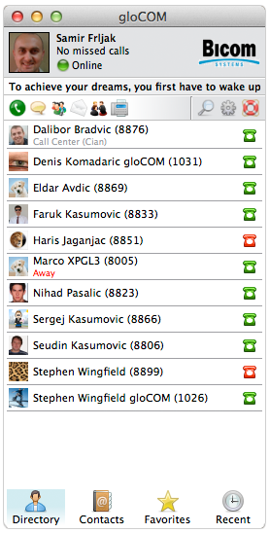

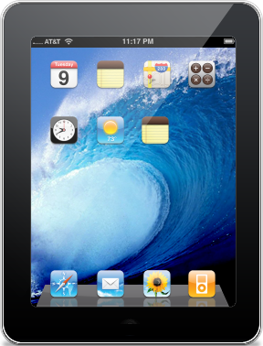

Future
All Endpoints are treated with equal status as equal integral parts of the PBXware and provide users with equal sharing of presence status and functionality.
PBXware
One number
gloCOM + Desk Phone
End points
gloCOM + Smart Phone
End point
gloCOM + Desktop
End point
gloCOM + PAD
End point
www.bicomsystems.com

Slide 36

Future
NOW LET’S SEE HOW PBXWARE CAN HANDLE A CALL
A CALL COMES THROUGH PBXWARE TO AN RECEPTIONIST
RECEPTIONIST USES GLOOCOM ON A DESKTOP
THEN RECEPTIONIST FORWARDS THE CALL TO A
REMOTE WORKER WITH A SMART PHONE
REMOTE WORKER FORWARDS THE CALL TO
A COLLEAGUE IN THE OFFICE WHO USES DESK PHONE
COLLEAGUE IN THE OFFICE KNOWS THAT ONLY COMPANY SPECIALIST CAN HELP CALLING PARTY
HE THEN FORWARDS THE CALL TO A SPECIALIST WHO
HAPENS TO BE AT HOME USING HIS PAD
LET’S SAY WE HAVE A PBXWARE
UNFORTUNATELY SPECIALIST IS UNABLE TO ANSWER THE CALL
CALLING PARTY WILL BE SENT TO SPECIALIST VOICEMAIL BOX
PBXware
gloCOM + Smart Phone
End point
gloCOM + Desktop
End point
VoiceMail
gloCOM + PAD
End points
Desk Phone
End points
www.bicomsystems.com

Slide 37
S-NET Communications
Case Study
OVERVIEW
Communication Services Provider to SMB
Advanced systems & features with stability and reliability
www.snetconnect.com
CHALLENGE
Find a platform on which to run business
Tried the competition, not please
Needs: reliability, stability, ease-of-use, flexibility
www.bicomsystems.com

Slide 38
S-NET Communications
Case Study
SOLUTION
PBXware Multi Tenant PBX
Could now support demand
Made business plan a working reality
IMPLEMENTATION
Migrated 2500 extensions
Few problems, Bicom Systems worked through them
www.bicomsystems.com

Slide 39
S-NET Communications
Case Study
RESULTS
Now use Cloud Telephony Systems
New clients through United States
Promise to investors: sell 200 more extensions per day
www.bicomsystems.com

