Slide 1

PBXware Presentation
www.bicomsystems.com

Slide 2

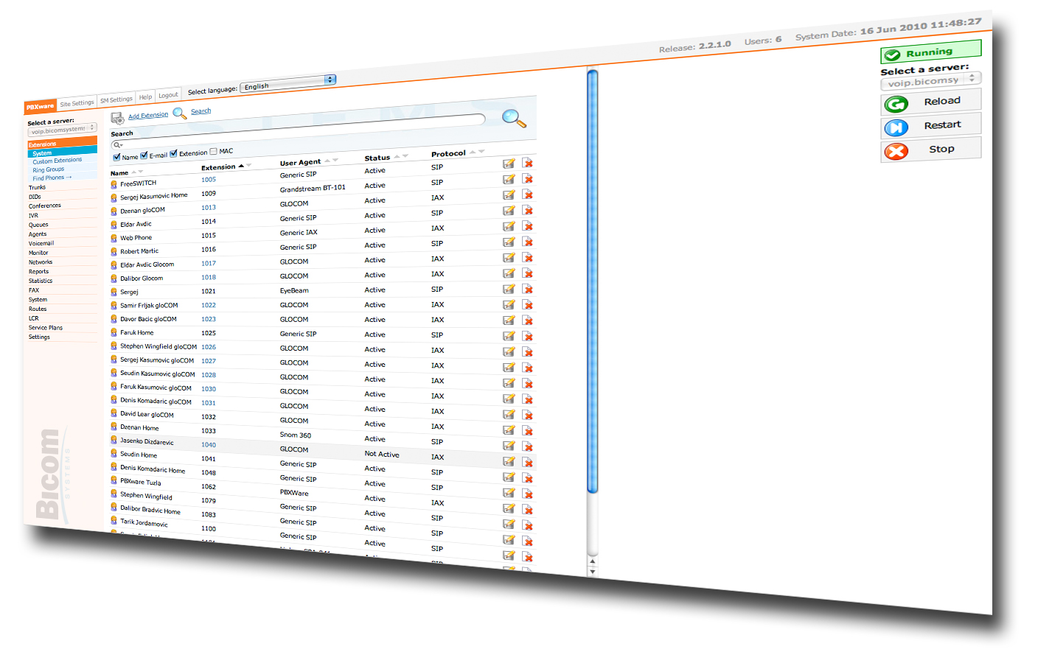
PBXware Introduction
PBXware
History
Editions
Features

Slide 3
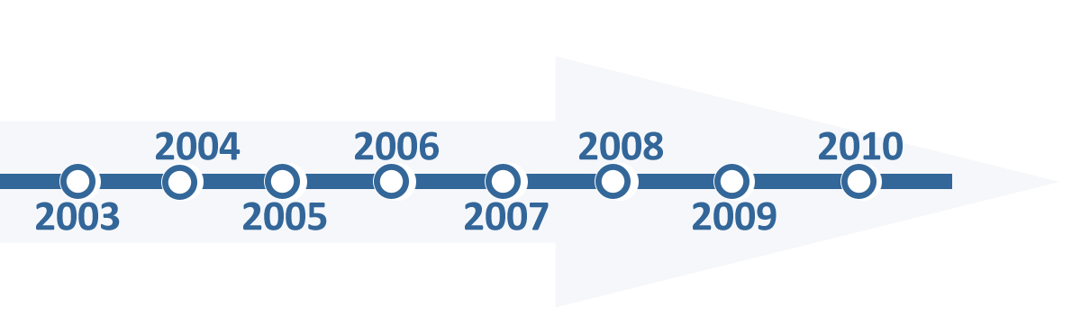
PBXware History
Summer 2003, research started based on asterisk, an open source telephony engine
Dec 2003, PBXware development was initiated
July 2004, First customer install
Sep 2004, first public demonstration in Atlanta, Georgia, USA

Slide 4
PBXware Editions
Business
Call Centre
Multi Tenant
Edition
Edition
Edition
PBXware Business Edition provides the business class features required by today's demanding communications needs that all businesses face. In addition to the standard features of all New Generation IPPBXs, Bicom System's Business Edition includes comprehensive enhanced services, telephony applications, system administration, end user applications, customization, reliability and setup and configuration features in a truly scalable manner.
The Call Center edition offers a set of features needed for an organization to effectively start and manage inbound or outbound call campaigns. Unlimited ACD Queues, Unlimited call agents, comprehensive reporting, real time queue statistics, real time queue monitoring, soft phone, optional predictive inbound and out bound dialing, skills based routing to name a few.
The Multi Tenant edition of PBXware allows service providers to serve the IP-PBX market with fully featured, hosted IP-PBX solutions and unlimited tenants. Unlimited resellers, user/company self portal, LCR are just some of advanced features included.

Slide 5
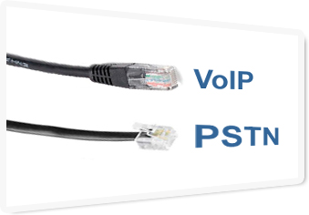
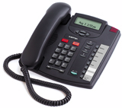
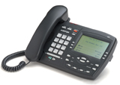
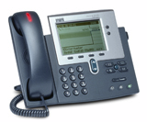
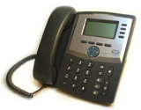
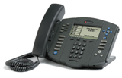
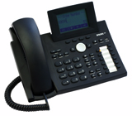
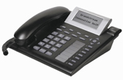
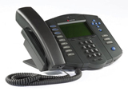
Supported Technologies
Business
Call Centre
Multi Tenant
edition
edition
edition
VoIP & PSTN Telephony
PBXware support VoIP and traditional PSTN telephony technologies.

Slide 6




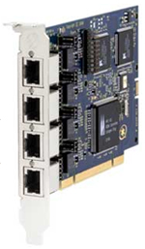
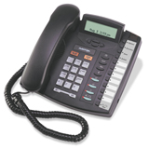

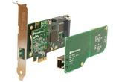
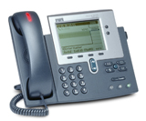
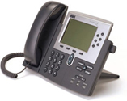
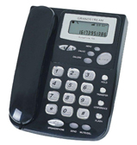
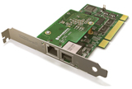
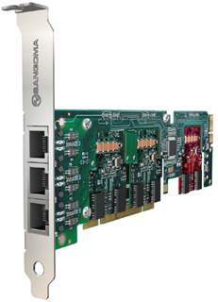


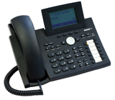
Supported Devices
Supported Technologies
Business
Call Centre
Multi Tenant
edition
edition
edition
edition
PBXware supports a wide range of VoIP & Analog cards and devices.

Slide 7
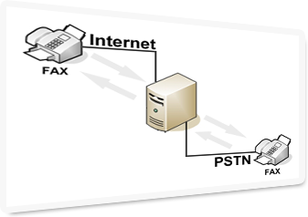
Faxing
Business
Call Centre
Multi Tenant
edition
edition
edition
Fax Over IP
& Traditional Faxing
Fax Over IP and traditional PSTN faxing allows exchanging fax calls between two fax machines, connected to a network (Internet) or/and to a traditional phone line.

Slide 8

IVR
Business
Call Centre
Multi Tenant
edition
edition
edition
Interactive Voice Response
Interactive Voice Response allows managing of incoming calls. PBXware answers the calls, interact with the callers and forward the calls to appropriate choice made by the callers.

Slide 9

Conference Calling
Business
Call Centre
Multi Tenant
edition
edition
edition
Conference Calling
Conference calling allows users to join a talk or listen to many people at same time.

Slide 10
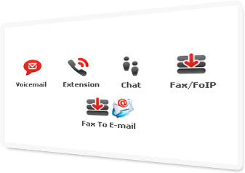
Unified Messaging
Business
Call Centre
Multi Tenant
edition
edition
edition
Unified Messaging
Voicemail
Instant Messaging Chat,
Faxing (PSTN, FoIP, FoE)
SMS

Slide 11

Call Monitoring
Business
Call Centre
Multi Tenant
edition
edition
edition
Call Monitoring
Listening to calls
Whispering
Barging into calls

Slide 12
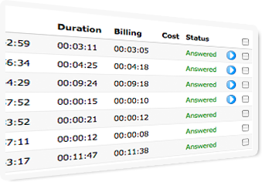
Call Recording
Business
Call Centre
Multi Tenant
edition
edition
edition
Call Recording
System Wide Call Recording
Call recording per user extension
Instant Recording

Slide 13

ACD Queues
Business
Call Centre
Multi Tenant
edition
edition
edition
ACD Queues
Unlimited Agents and Queues
Ringing Strategy
Call Recording
Predictive Dialer
Queue Call Back

Slide 14
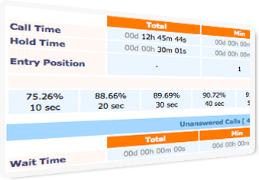
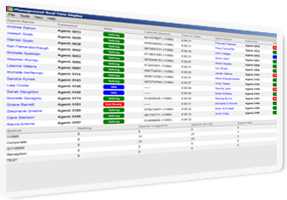
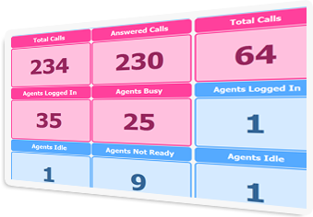
Enhanced Call Statistics
Business
Call Centre
Multi Tenant
edition
edition
edition
Call Center Statistics
Queues/Agents statistics and real time
status
Inbound/Outbound Graphs
CSV and PDF Data Export
Windows, Mac and Linux Desktop
Applications
AQMON
ACMON

Slide 15
gloCOM (Global Communicator)
Business
Call Centre
Multi Tenant
edition
edition
edition
GloCOM
(Global Communicator)
VoIP Soft Phone
Instant Messaging Client
Operator Panel
Conference Administration
Call Centre Communicator
Fax Send/Receive
MS Windows Desktop Application

Slide 16

CRM/CTI Integration
Business
Call Centre
Multi Tenant
edition
edition
edition
CRM/CTI Integration
PBXware is ready for SugarCRM, SalesForce or any other proprietary CRM integration using our custom development service.

Slide 17
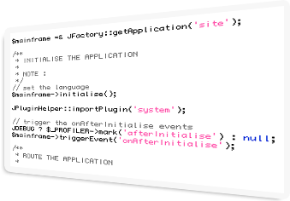
Custom Development
Business
Call Centre
Multi Tenant
edition
edition
edition
Custom Development
We develop custom features and business applications by harnessing the power of Open Standards Technology with our worldwide developer teams.

Slide 18



Case Studies

Slide 19

www.legalaid.on.ca
Government Breaking Free of Traditional PBX Vendors
(Bicom Systems)

Slide 20

Overview
Legal Aid Ontario est. 1998
Independent Government funded Organisation
Aim to strengthen the provision of Legal Aid throughout the Province
Ten years of Growth:
Central Office of 400 users and 200 branch offices across the province
Traditional Phone System had to go - but public finances were limited

Slide 21
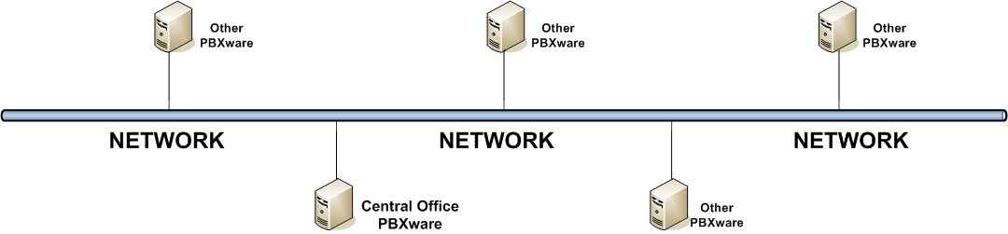
Challenge
3 months to deliver 450 users with CALL CENTER of 40 users
3 months to have all staff trained for new system
Easy ability to Network the 200 centres and remove the cost of LD

Slide 22
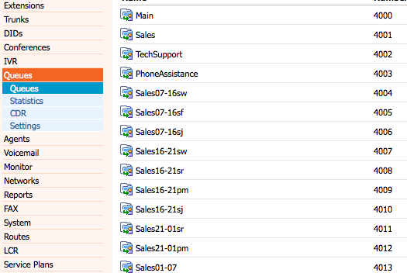
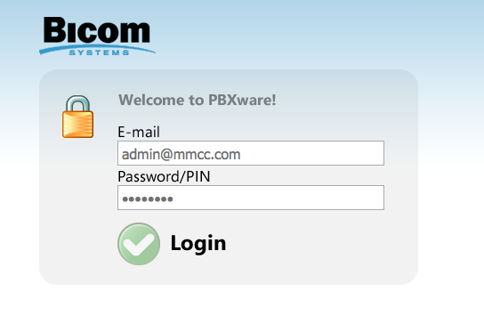
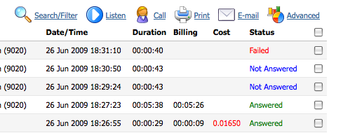
Solution
OPEN STANDARDS Hardware
Call Center and Business Edition at HQ
officeBOX appliance at branch offices
"Professional Warranted Turnkey Solution" : PBXware

Slide 23

Results
May 2008, Job Done!
Call Center Supervisors: started after a day of training
Control of busy times - using remote workers
Control of agents' performance
LIBERATION from Traditional Vendors
“It simply takes less time than
the traditional systems we had before,”
said Tracy Chen.

Slide 24
www.11890.ie

Slide 25


Overview
The Coolest DIRECTORY INQUIRY SERVICE in Ireland
40,000 Calls per Day
9 million Calls per Year
HIGH PRESSURE ENVIRONMENT
RENEWAL of their TRADITIONAL PHONE SYSTEM

Slide 26

Challenge
1. Improve EFFICIENCY
2. Improve RELIABILITY
3. Improve ERGONOMICS
4. To LIBERATE

Slide 27
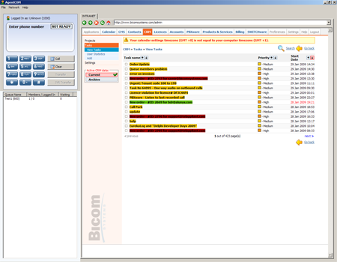
Solution
PBXware CALL CENTER Edition
OPEN STANDARDS Hardware - Single Server
Inbuilt Call Centre Statistics
CRM Integration
AGENTCOM :
Single Desktop Screen for Agents

Slide 28
Results
SYSTEM NOT CRASHED
35% Gain in Productivity
Huge Reduction in Costs
Agents have much happier WORK PLACE
Supervisors CONTROL System and Agents
LIBERATION from Traditional Vendors
…. Advanced Simplicity

Slide 29

http://jpl.nasa.gov
PBXware going further than any other PBX has gone before
(Bicom Systems)

Slide 30

Overview
http://jpl.nasa.gov (Jet Propulsion Laboratory)
JPL is the lead US center for robotic exploration of the SOLAR SYSTEM
JPL research collaborates efforts of SCIENTISTS around the world

Slide 31

Challenge
  6 WEEKS to deliver: CONFERENCE SOLUTION that was a First!
  Supervisor to Monitor 20 conferences CONCURRENTLY
  Supervisor : EASY user and conference management
  Users: EASY to use desktop conferencing and instant messaging

Slide 32
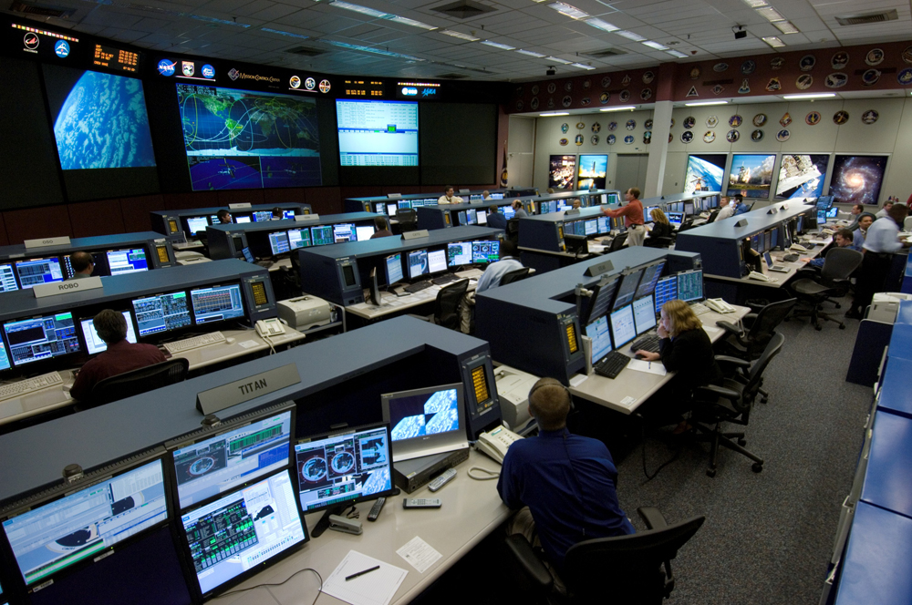
Solution
  PBXware business edition installed on FIVE nines server
  Custom developed conference monitoring solution
  Modified gloCOM to support conferencing administration
  Developed Conferencing Desktop
  Application for End Users

Slide 33

Results

Slide 34



























Other Bicom Systems Customers

